Slide 1
E-GP in World Bank funded Projects
Swayamsiddha Mohanty
Senior Procurement Specialist,
Solutions and Innovations in Procurement
Governance Global Practice, The World Bank,
January, 2019, New Delhi, India

Slide 2
OBJECTIVE OF THE PRESENTATION :
The objective of this presentation is :
To explain the e-GP system assessment requirement of the Bank
To share information on use of NIC e-GP system in World Bank funded projects and Bank’s work in the area of e-GP in India

Slide 3
India Portfolio OF THE WORLD BANK
Total no. of Projects = 103
Net commitment amount (million USD) = 27,260
Percentage of use of e-GP in India portfolio = 68%
NIC e-GP system used in major portion of the portfolio

Slide 4
BENEFITS OF USE OF e-GP
Enable tendering systems to be used online
Equal Opportunity - Give a much wider reach to tenders
Transparency - Provide privacy and confidentiality to the documents within the tenders
Keep the information regarding vendors confidential
Reduce the human interface as much as possible by allowing the vendors to provide information and quote online
Process Efficiency

Slide 5
E-GP system assessment requirements
MDB e-tendering guidelines (common for all multi-lateral development Banks)
Based on the principles of
  transparency,
  non-discrimination,
  equality of access,
  open competition,
  accountability and
  security of process

Slide 6
MDB Guidelines on e-GP Assessment
System Access
Advertising
Bidding Documents
Correspondence, Amendments, SUBSTITUTIONS & Clarifications
Submission of Bids/Proposals
Bid Securities
Public Bid Opening
Bid Evaluation and Contract Award
Information Security Management
Authentication
Payment

Slide 7
Assessment of NIC system
NIC GePNIC system was assessed under PMGSY RRP-II Project and was approved in June 2011.
Worked together with NIC towards system improvement in the area of capacity building, enhancing the system for foreign bidder participation, security audit of every installation, enhancing the help manuals etc.
Continuous engagement with NIC through the years for system improvement and alignment with MDB requirements and International best practices
World Bank specific requirements have been incorporated in the system
NIC e-GP system (CPPP) won the South Asia Procurement Innovation Award in 2018
Work in progress in the area of e-BG and codification

Slide 8
Work on Data ANALYTICS
E-GP Data Analyzed on 5 indicators :
  Competitiveness
  Effectiveness and Value for Money
  Transparency & Accountability
  Trust of bidder’s community
  System Performance
Impact – System improvement in the area of item codification and Data Analytics

Slide 9
About the Study
Procurement spend analysis done based on 3 years of tender data taken from NIC e-GP systems
Three States: Odisha (08-09, 09-10 & 10-11) Jharkhand (11-12, 12-13 & 13-14) and Assam (10-11, 11-12, 12-13 & 13-14)
Number of tenders analyzed: Odisha (25947) Jharkhand (9340) and Assam (2124)

Slide 10
About the Study
Version 14.0801 of the UNSPSC code-set used to categorize tenders
UNSPSC is a hierarchical code-set: Segment (56), Family (420), Class (3819) and Commodity (49022)
Assignment of item code done at the tender level

Slide 11
About the Study
Performance Indicators
Competitiveness
Effectiveness and Value for Money
Average number of bidders per tender
Percentage of zero bid tenders
Increase / decrease in awarded price vs. estimated price
Time taken to complete bid evaluation
Savings in advertisement costs
Savings in photocopy / printing

Slide 12
About the Study
Performance Indicators
Governance (Transparency and Accountability)
Trust of Private Sector / Bidder’s Community
Publication of Award of Contract
System Performance

Slide 13
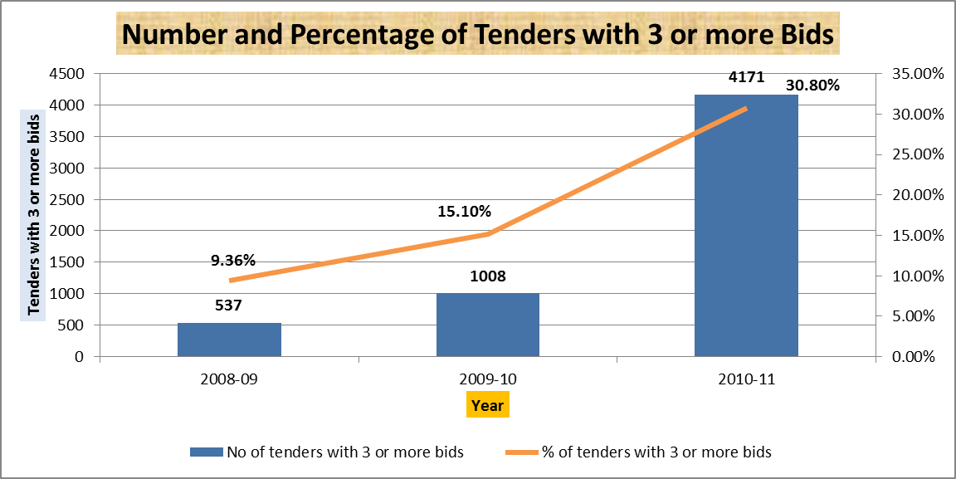
Key Findings from the Study (Odisha)
Competitiveness

Slide 14
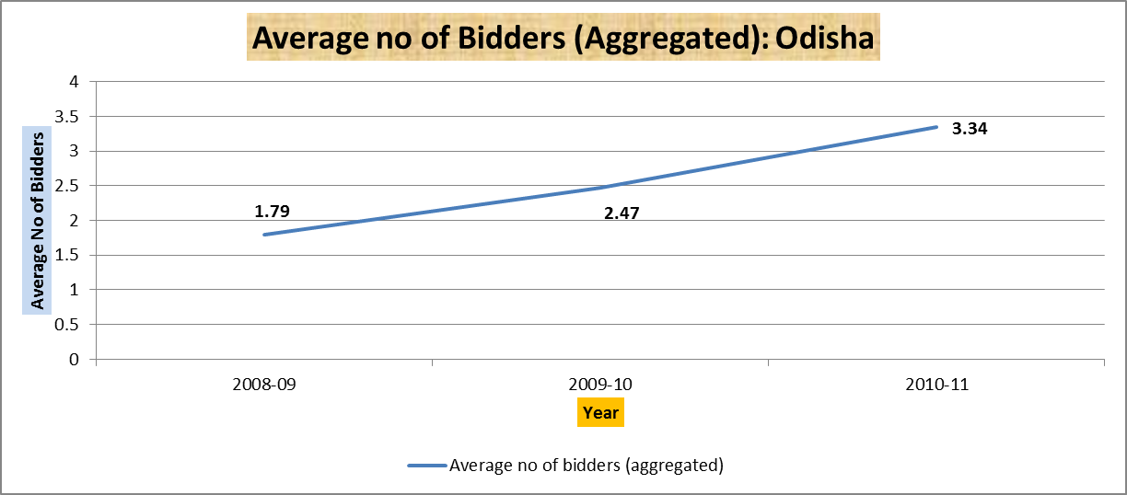
Key Findings from the Study (Odisha)
Competitiveness

Slide 15
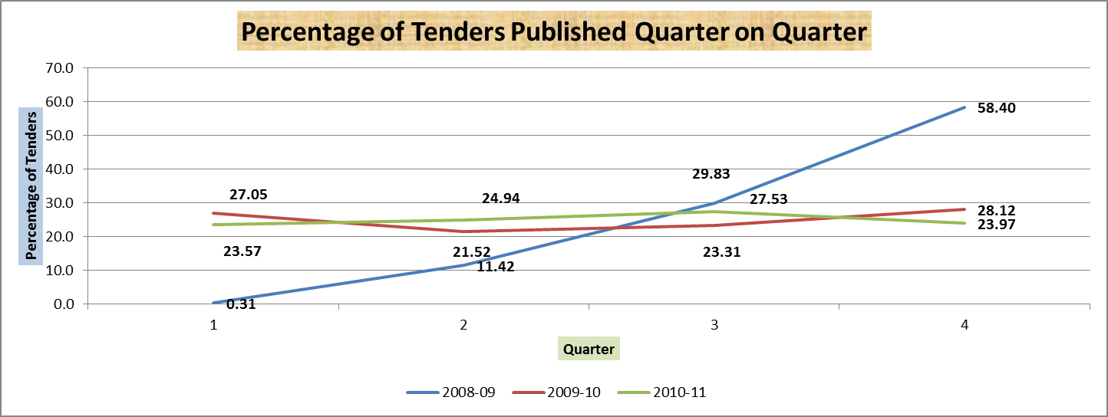
Key Findings from the Study (Odisha)
Effectiveness & Value for Money

Slide 16
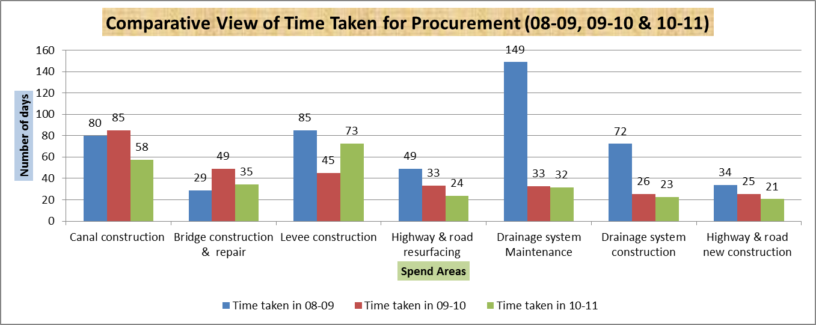
Key Findings from the Study (Odisha)
Effectiveness & Value for Money

Slide 17
Key Findings from the Study (Odisha)
Governance (Transparency & Accountability)
Transparency is score high at 4.27 (out of 5) in in e-GP vs. 2 in manual system
Ease of bid submission is higher at 3.9 in e-GP vs. 2.27 in manual system
Number of visits to Government office reduced by 5.08 days per tender in e-GP
Speed of NIC system is rated well, complexity is moderately rated

Slide 18
Key Findings from the Study (Odisha)
Average number of bidders
Reduction in zero bid tenders
2008-09 = 1.79 bids
2009-10 = 2.47 bids &
2010-11 = 3.34 bids
2008-09 = 55%
2009-10 = 50% &
2010-11 = 19%

Slide 19
Key Findings from the Study (Odisha)
Time taken to complete procurement
Transparency in Government Procurement
2008-09 = 51.56 days
2009-10 = 32.68 days
2010-11 = 24.80 days
2008-09 = 13.10%
2009-10 = 8.19%
2010-11 = 5.01%
Percentage of tenders with Award of Contract

Slide 20
Key Findings from the Study (Odisha)
Transparency in Government Procurement
Ease of bid submission is higher at 3.9 in e-GP vs. 2.27 in manual system
Number of visits to Government office reduced by 5.08 days per tender in e-GP

Slide 21
Thank You
☺

